Slide 1
CSE 460: VLSI Design
LECTURE 8
STATE ASSIGNMENTS USING
GRAY CODING & ONE-HOT ENCODING

Slide 2
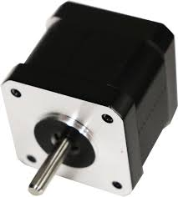
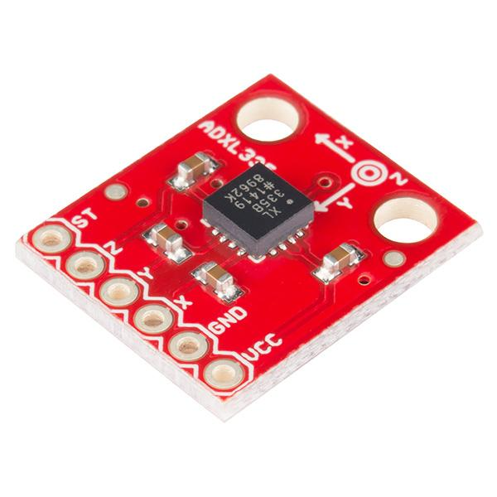
Motor Speed Controller
Case Study Example 1
Clock
Speed
Controlling
Mechanism
z
Speed
Controller
FSM
Reset
Comparator
w
DC Motor
Accelerometer
20 rpm

Slide 3

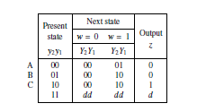
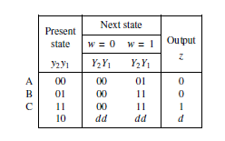
State Assignment Problem : Case Study Example 1
Initial Assignment
Improved Assignment
Figure 8.16.
Improved state assignment for the sequential circuit in Figure 8.4. Example 1

Slide 4
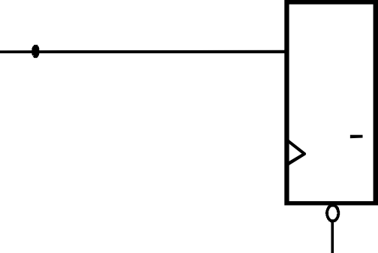
Initial Assignment
Improved Assignment
Y₂
y₂
D
Q
z
Y₂
y₂
z
Q
D Q
Q
Y₁
y₁
w
D
Q
Y₁
y₁
w
D
Q
Q
Clock
Q
Resetn
Y₁=w; Y₂=wy₁; z=y₂
Clock
Resetn
Y₁=wy₁y₂;
Y₂=w(y₁+y₂); z=y₂
Figure 8.17.
Final circuit for the improved state assignment in Figure 8.16.

Slide 5
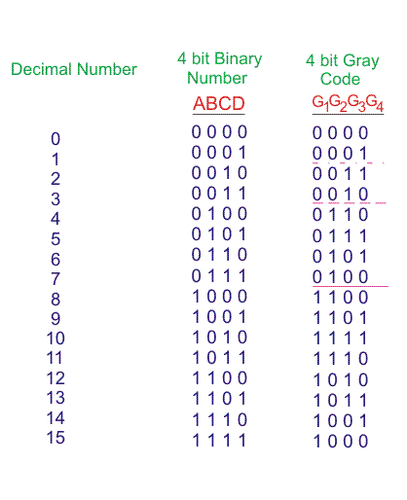

Slide 6
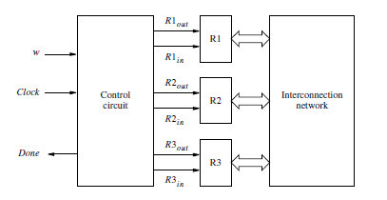
Swapping Contents of two registers
Case Study Example 2

Slide 7



















Improved State Assignment : Case Study 2 Example 2
Present state | Nextstate |  | Outputs
00 | 0 0 | 01 | 0 | 0 | 0 | 0 | 0 | 0 | 0
01 | 1 1 | 11 | 0 | 0 | 1 | 0 | 0 | 1 | 0
11 | 1 0 | 10 | 1 | 0 | 0 | 1 | 0 | 0 | 0
10 | 0 0 | 00 | 0 | 1 | 0 | 0 | 1 | 0 | 1
A B C D
Figure 8.18.
Improved state assignment for the sequential circuit in Figure 8.12.

Slide 8
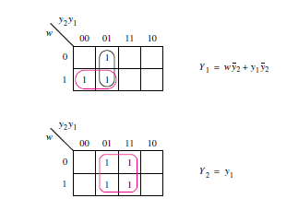
Figure 8.19.
Derivation of next-state expressions for the sequential circuit in Figure 8.18.

Slide 9
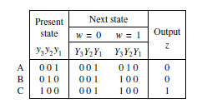

ONE-HOT Encoding : Case Study Example 1
Clockcycle:
^{t}0 ^{t}1 ^{t}2 ^{t}3 ^{t}4 ^{t}5 ^{t}6 ^{t}7 ^{t}8 ^{t}9 ^{t}10
w : 0 1 0 1 1 0 1 1 1 0
z : 0 0 0 0 0 1 0 0 1 1 0
Present state | Next state |  |  |  |  |  | Output z
 | w | = | 0 | w | = | 1
A | A |  | B |  |  |  | 0
B | A |  | C |  |  |  | 0
C | A |  | C |  |  |  | 1
Figure 8.4. State table for the sequential circuit in Figure 8.3.

Slide 10
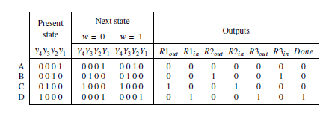

ONE-HOT Encoding : Case Study Example 2
Figure:
One-hot state assignment of the sequential circuit for swapping register contents

